Slide 1
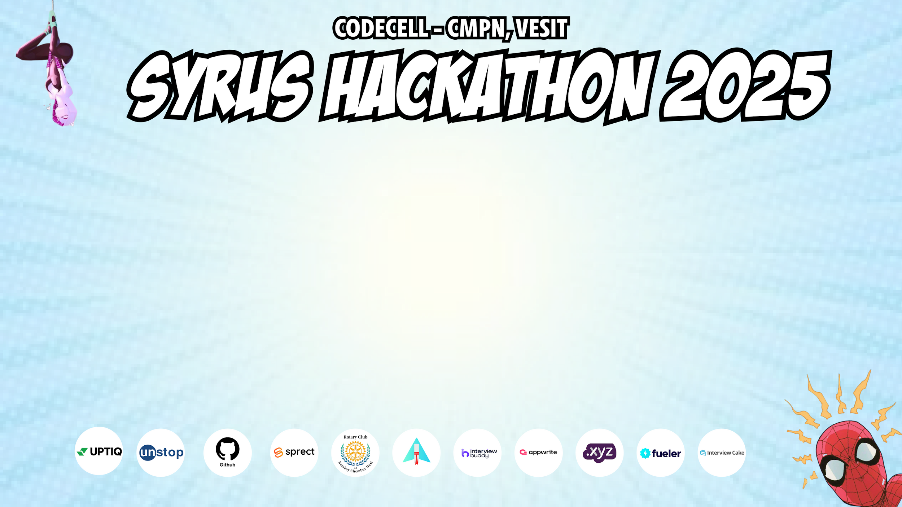
Category Code : C1
Problem Statement Title : MentorNet - AI-Powered Web3 Decentralized Mentorship Platform.
Team Name : Arjun[D]
Institute Name : Vivekanand Education Society’s Institute of Technology

Slide 2

Idea / Approach details (& implemented features)
Idea / Approach :
The project aims to create a decentralized mentorship platform using AI and blockchain for trust, transparency, and skill validation. It connects students with verified mentors, provides AI-driven guidance, and ensures fraud-proof skill certification, fostering an accessible and secure learning ecosystem.
Implemented Features :
User Dashboard built using Next.js 15 for a seamless and interactive experience.
Smart Contract Deployment using Solidity and the Polygon(Amoy) testnet for secure and efficient transaction .
Mentor Authentication with Wallet Connection using Wagmi and RainbowKit ensuring decentralized identity verification.
Decentralized Career Portfolio where skills, projects, certificates, and mentorship sessions are stored on IPFS and verified on the blockchain.

Slide 3
Innovation (Showstopper)
1. AI-Driven Mentorship :
Leverages Large Language Models (LLMs) to provide individualized career advice.
Real-time skill gap analysis and adaptive learning paths.
AI-generated real world projects with expert feedback loops.
2. Decentralized Platform :
Constructed on the Web3 architecture with Mentor DAO.
Community-involved administration utilizing token-based motivation for mentors.
Transparent and immutable mentor-student interactions.
3. Blockchain-Based Certification :
Transparent monitoring of learning progress and work achievements.
Improved believability is enhanced through tamper-e
4. Soulbound Token Integration :
NFT-based skills qualification not transferable and unique to each user.
Ensures authentic and verifiable proof of skills and achievements.
Encourages confidence and trust in mentorship ecosystem.

Slide 4
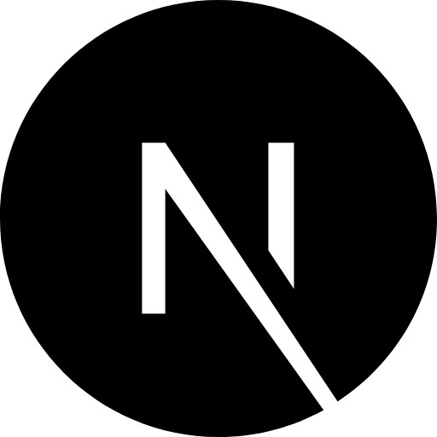









Tech Stack
Category | Tech Used
Frontend | Next.js 15, React 19, Tailwind CSS, shadcn/ui, Framer Motion.
Backend | Next.js Api Routes, Supabases [PostgreSQL] , Prisma Orm.
Blockchain | Solidity, Hardhat, Alchemy, Pinata (IPFS) & OpenZeppelin.
DevOps & Deployment | Vercel, Docker, Amazon EC2.

Slide 5
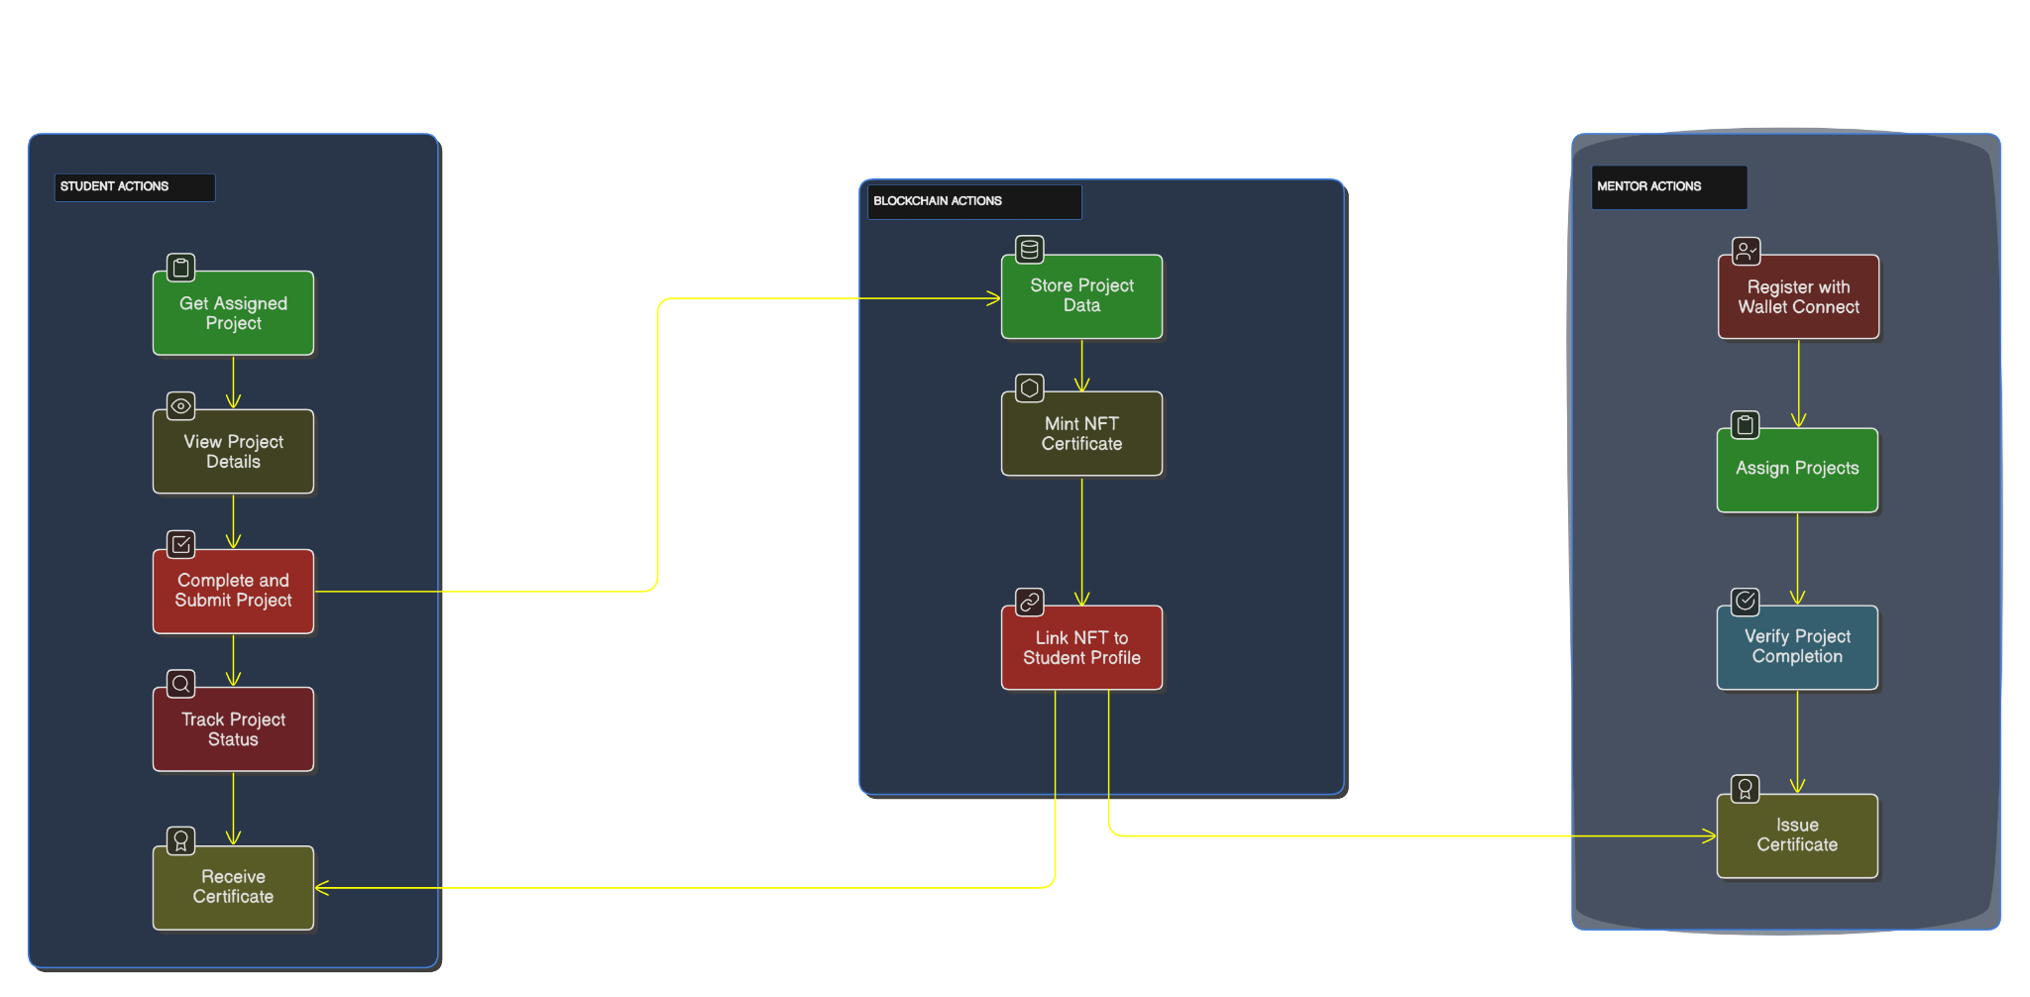
Use Case Diagram
MENTOR.NET FLOW

Slide 6
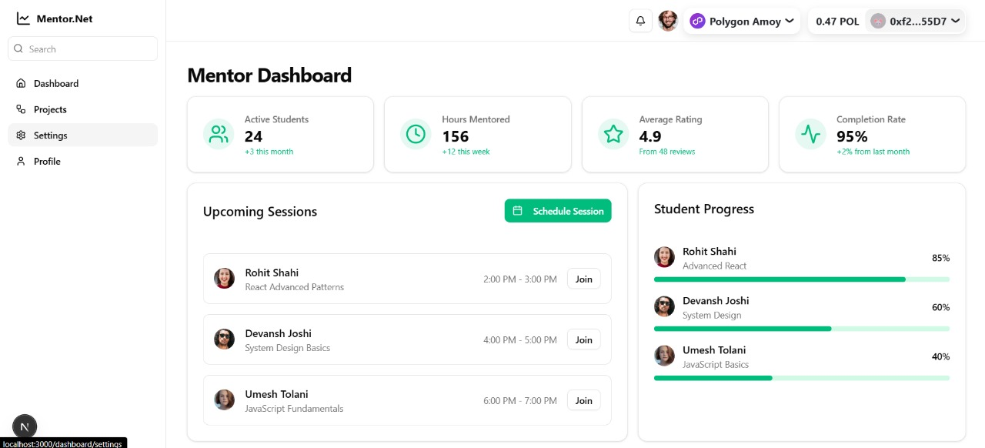
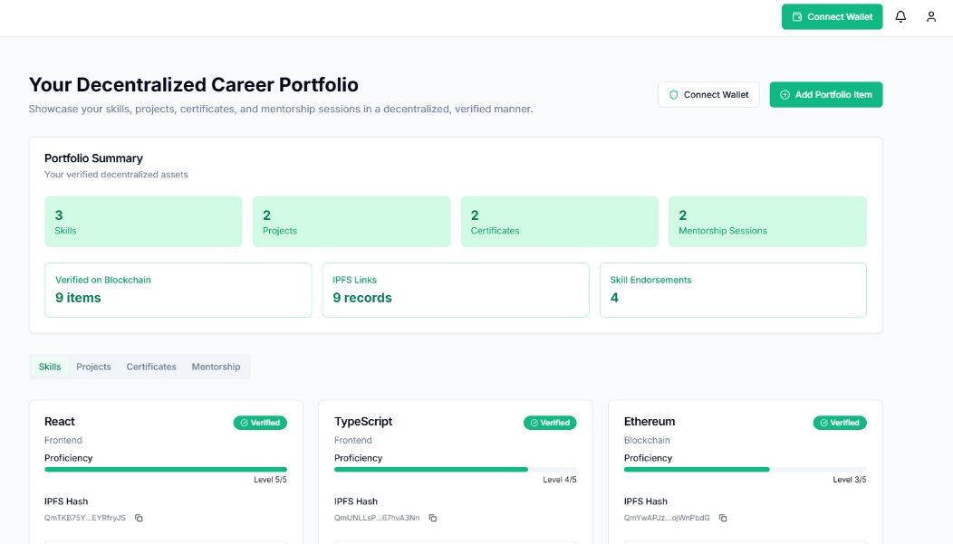
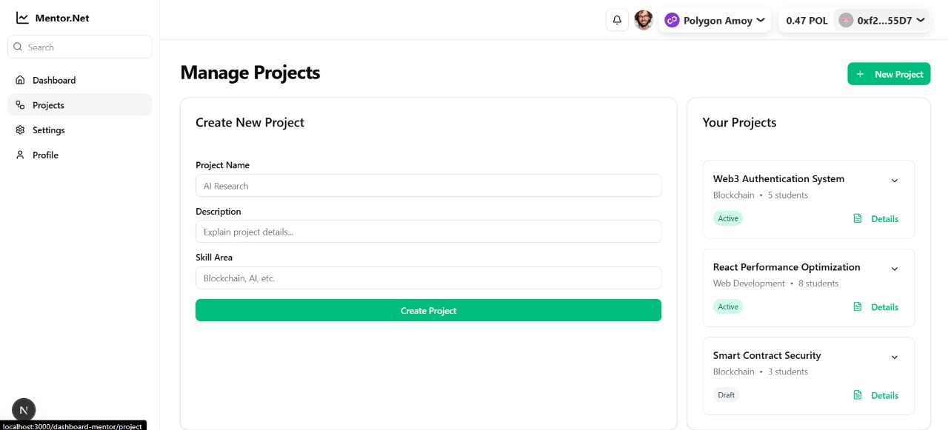
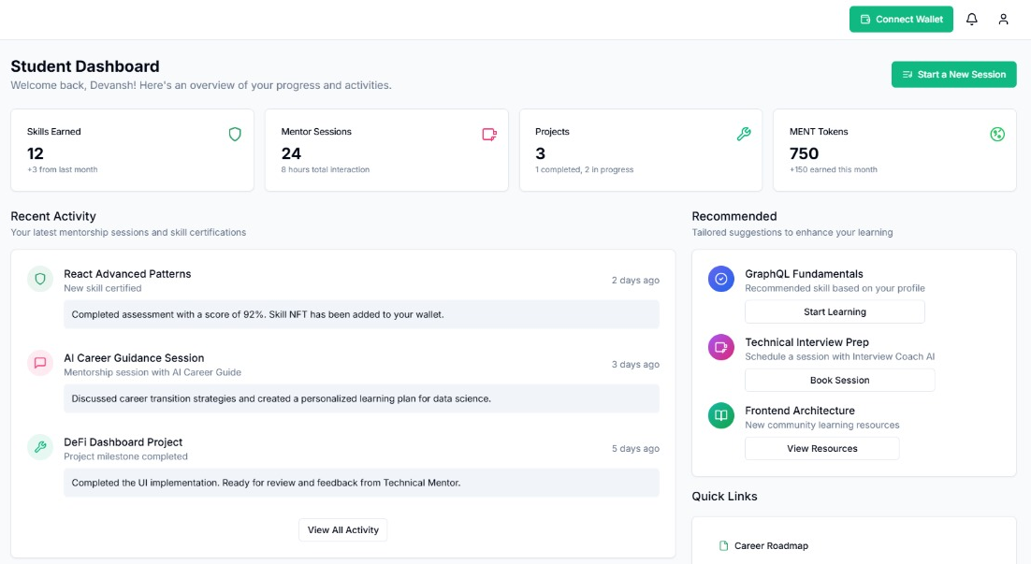
Implementation ScreenShots

Slide 7
Future Objectives
Certification Issuance through Soulbound Tokens – Secure non-transferable digital certificates for verified skills and accomplishments.
AI-Driven Mentor-Student Matching – Smart recommendations based on skills, interests, and career goals.
AI-Powered Industry Trend Analysis – Real-time insights into job market trends to guide career decisions.
Token Based Incentives - Earn tokens for learning mentoring and completing milestones.
Crypto Rewards for Mentors – Recognizing contributions with blockchain-based rewards.

